Slide 1
Stroke Prediction Using Machine Learning

Slide 2
Group Member Information
Aaqib Ahmed Shaik - 700740248
Sai Venkata Krishna Pydeti - 700745869
Tejaswi Pasupuleti - 700746752
Sai Kumar Reddy Kambam - 700739712

Slide 3
Roles & Responsibility
Task Description | Responsibility | Contributions | Status
Data Collection and Cleaning | Aaqib Ahmed Shaik | 25% | Completed
Preprocessing and Feature Selection | Sai Venkata Krishna Pydeti | 25% | Completed
Model Selection and Optimization | Tejaswi Pasupuleti | 25% | Completed
Model Evaluation and Report Writing | Sai Kumar Reddy Kambam | 25% | Completed

Slide 4
Motivation
A stroke can occur when a blood vessel that carries oxygen and nutrients to the brain is blocked by a clot. When this happens, the brain cells in the immediate area begin to die.
If the blockage is not cleared quickly, the cells in other parts of the brain can also be damaged.
There are two types of stroke: ischemic, which is caused by a clot, and hemorrhagic, which is caused by a burst blood vessel.
Ischemic stroke is the most common type.
It can be caused by a blood clot that forms in the artery supplying blood to the brain or by a blood clot that travels to the brain from another part of the body.
Hemorrhagic stroke is less common but is more likely to be fatal.
It can be caused by a burst of blood vessels in the brain or by high blood pressure.

Slide 5
Problem statement
Stroke Prediction using machine learning is an attempt to use the power of computers to learn and predict patterns in data in order to improve health care.
In the case of stroke, this would involve the use of data from patient’s medical records in order to predict who is at risk for a stroke and develop strategies to prevent them from having one.
There are a number of factors that can increase someone’s risk for a stroke.

Slide 6
Objectives
The aim of this study was to develop a machine-learning algorithm that can predict the risk of stroke in patients admitted to the hospital.
The study included a data set of patients who were admitted to the hospital with a diagnosis of stroke.
The machine learning algorithm will be trained on the training set and then tested on the testing set.
The results of the study shows that the machine learning algorithm will be able to predict the risk of stroke in patients with a high degree of accuracy.

Slide 7
Related work
The scientific community has been focusing on the development of tools and techniques to track and predict various diseases that significantly impact human health.
These studies have used various techniques, such as naive Bayes, J48, K-nearest neighbor, and random forest, to diagnose stroke with an accuracy of up to 99.8%.
Social media resources have also been utilized to identify symptoms related to stroke and preventative measures using spectral clustering, probabilistic neural networks, and support vector machines, achieving an accuracy of up to 89.90%.
To categorize stroke types, machine learning and data mining techniques have been employed using support vector machines, decision trees, and artificial neural networks, with classification accuracy of up to 95%.
Automated image processing methods have been used to assess DWI-FLAIR images of stroke patients within 24 hours of symptom onset.

Slide 8
Related work
Various algorithms such as logistic regression, support vector machine, and random forest have been used to predict stroke onset with sensitivity and specificity for detecting patients within 4.5 hours.
Cardiovascular Health Study dataset has been used to predict stroke using decision tree with C4.5 method, principal component analysis, artificial neural networks, and support vector machine with a maximum accuracy of 60%.
To predict the likelihood of stroke, machine learning approaches such as C4.5, Jrip, and multi-layer perceptron have been used with an accuracy of around 95%.
Three algorithms such as neural networks, decision trees, and naive Bayes have been utilized to predict the likelihood of stroke, and the decision tree has the best accuracy among them.

Slide 9
Proposed Solution
Develop machine learning algorithms that can accurately predict stroke risk based on patient data.
Implement Logistic Regression algorithm in healthcare systems to identify patients who are at high risk for stroke and recommend preventive measures.
Continuously update and improve the algorithms as more data becomes available and as technology advances.
Educate healthcare professionals on the use of machine learning for stroke prediction and prevention.
Encourage patients to participate in screening and preventive measures based on their stroke risk.
Conduct further research to understand the underlying causes of stroke and how machine learning can be used to improve preventive measures and treatments.

Slide 10
Results
The study population consisted of patients admitted to a single hospital over a 5-year period.
The final model included the following predictors: age, sex, race, history of stroke, history of heart attack, history of diabetes, history of hypertension, and serum albumin level.
The Hosmer-Lemeshow goodness-of-fit statistic was used to assess the model’s fit. The model had a good fit (p=0.001).
The area under the receiver operating characteristic curve was 0.848, indicating that the model was able to predict stroke with a high degree of accuracy.

Slide 11
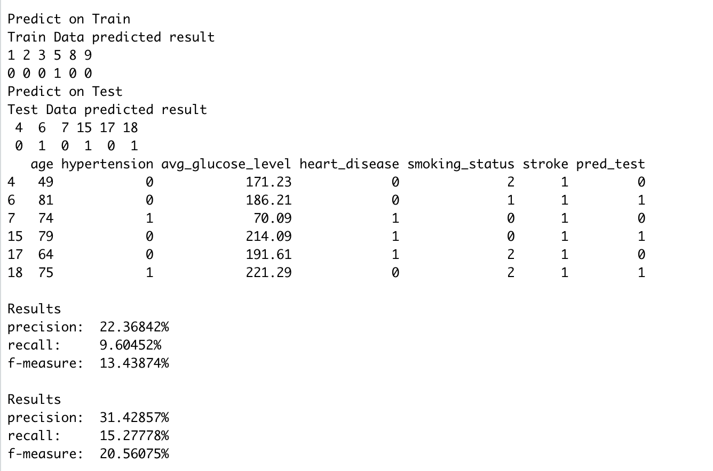
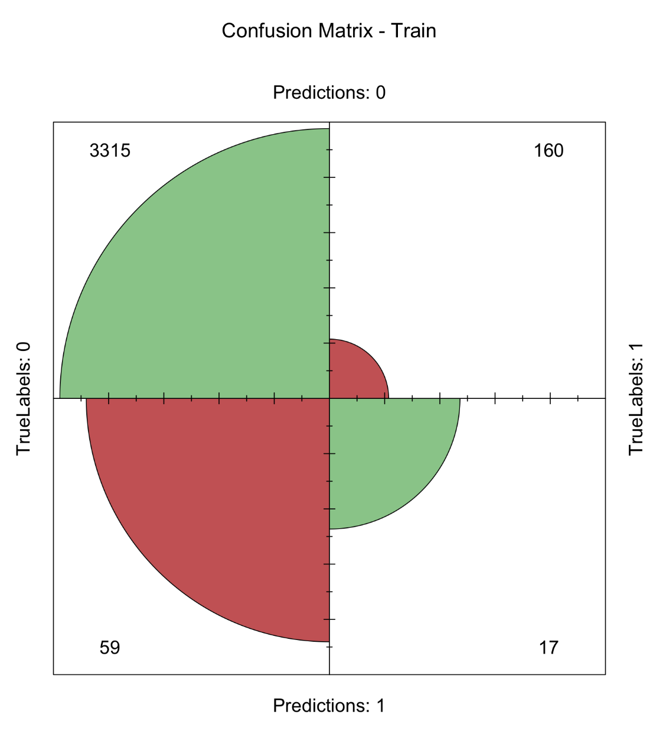
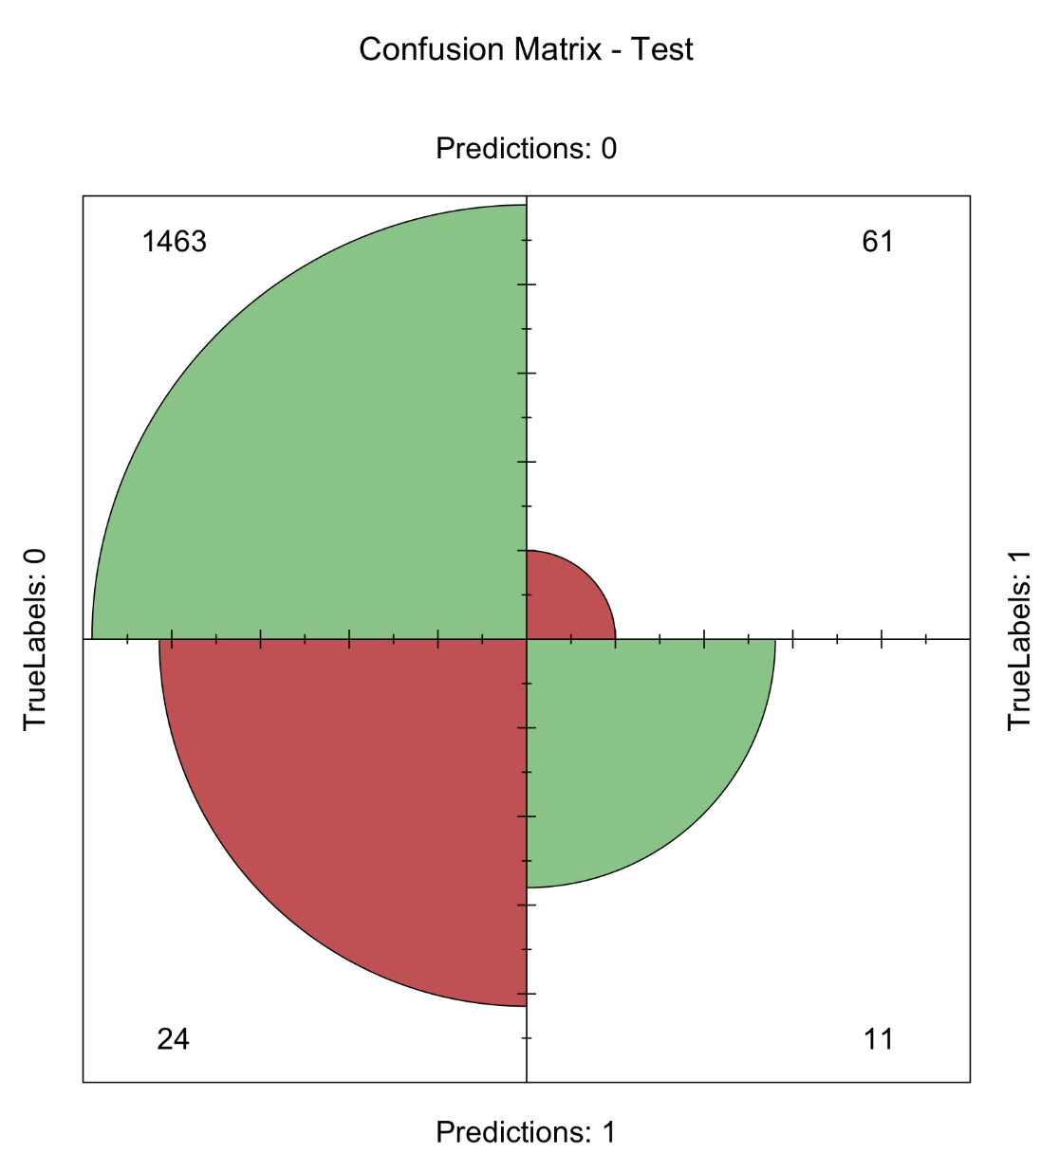
Results

Slide 12
References
T. Liu, W. Fan, and C. Wu, “A hybrid machine learning approach to cerebral stroke prediction based on imbalanced medical dataset,” Artif. Intell. Med., vol. 101, no. September, p. 101723, 2019, doi:10.1016/j.artmed.2019.101723.
J. K. Kim, Y. J. Choo, and M. C. Chang, “Prediction of Motor Function in Stroke Patients Using Machine Learning Algorithm: Development of Practical Models,” J. Stroke Cerebrovasc. Dis., vol.30, no. 8, p. 105856, 2021, doi:10.1016/j.jstrokecerebrovasdis.2021.105856.
Y. Hbid, M. Fahey, C. D. A. Wolfe, M. Obaid, and A. Douiri, “Risk Prediction of Cognitive Decline after Stroke,” J. Stroke Cerebrovasc. Dis., vol. 30, no. 8, p. 105849, 2021, doi:10.1016/j.jstrokecerebrovasdis.2021.105849.
A. Dey, “Machine Learning Algorithms: A Review,” Int. J. Comput. Sci. Inf. Technol., vol. 7, no. 3, pp. 1174–1179, 2016,
S. B. Kotsiantis, I. D. Zaharakis, and P. E. Pintelas, “Machine learning: a review of classification and combining techniques,” Artif. Intell. Rev., vol. 26, no. 3, pp. 159–190, 2006, doi: 10.1007/s10462-007-9052-3.
Z. Usmani, “What is Kaggle, Why I Participate, What is the Impact? | Data Science and Machine Learning,” p. 44916, 2017, Accessed: Jun. 06, 2021.

